Slide 1


Bank Loan Interest Rate Analysis DATA603
Group 23:
Warren Wang
Sharlin Kahlon
Gagandeep Thind
Cancan Chen
Chandanarchutha Namburu

Slide 2

Introduction:
The banking and financial sector is vital to the global economy through loan services for individuals and businesses.
Interest rates are influenced by borrower characteristics such as income, credit history, and employment status.
Understanding these factors helps optimize loan approval processes, reduce risks, and improve customer satisfaction.
Goal: Analyze bank loan data to understand borrower characteristics' impact on interest rates
Problem we are solving: Explore the relationship between borrower characteristics and interest rates.
Identify predictive features like income, employment length, loan amount, and creditworthiness.

Slide 3
Research Questions:
How do the independent variables (e.g., loan amount, income category, employment length, etc.) influence the interest rate?
Which independent variables are most predictive of the interest rate?
Can a multiple regression model be developed to effectively predict interest rates, and what levels of Adjusted R-squared and Residual Standard Error (RSE) can be achieved?
DATASET:
The dataset is from Kaggle which is an open data source
Link: https://www.kaggle.com/datasets/mrferozi/loan-data-for-dummy-bank?resource=download

Slide 4
Variables:
Variable | Description
Emp_length_int | employment length, measured in months, quantitative;
Home_ownership | whether the individual owns a house or not, it is a categorical variable, its types are mortgage, rent and other;
Income_category | qualitative variable, measured in: low, high and other
Annual_inc | the amount of annual income, measured in dollars, quantitative variable
Term | how long the term of loan is, measured in either 36 months or 60 months. Quantative;
Purpose | qualitative variable, measured in debt_consolidation, credit_card and other;
Interest_payments | qualitative variable, measured in high or low.
loan_amount | the amount of loan borrowed, measured in dollars; Quantitative variable
Grade | assigned loan grade, measured in B,C or other.
DTI | debt-to-income ratio, quantitative variable.
Interest_rate | our response variable, quantitative and continuous variable, its unit is %

Slide 5
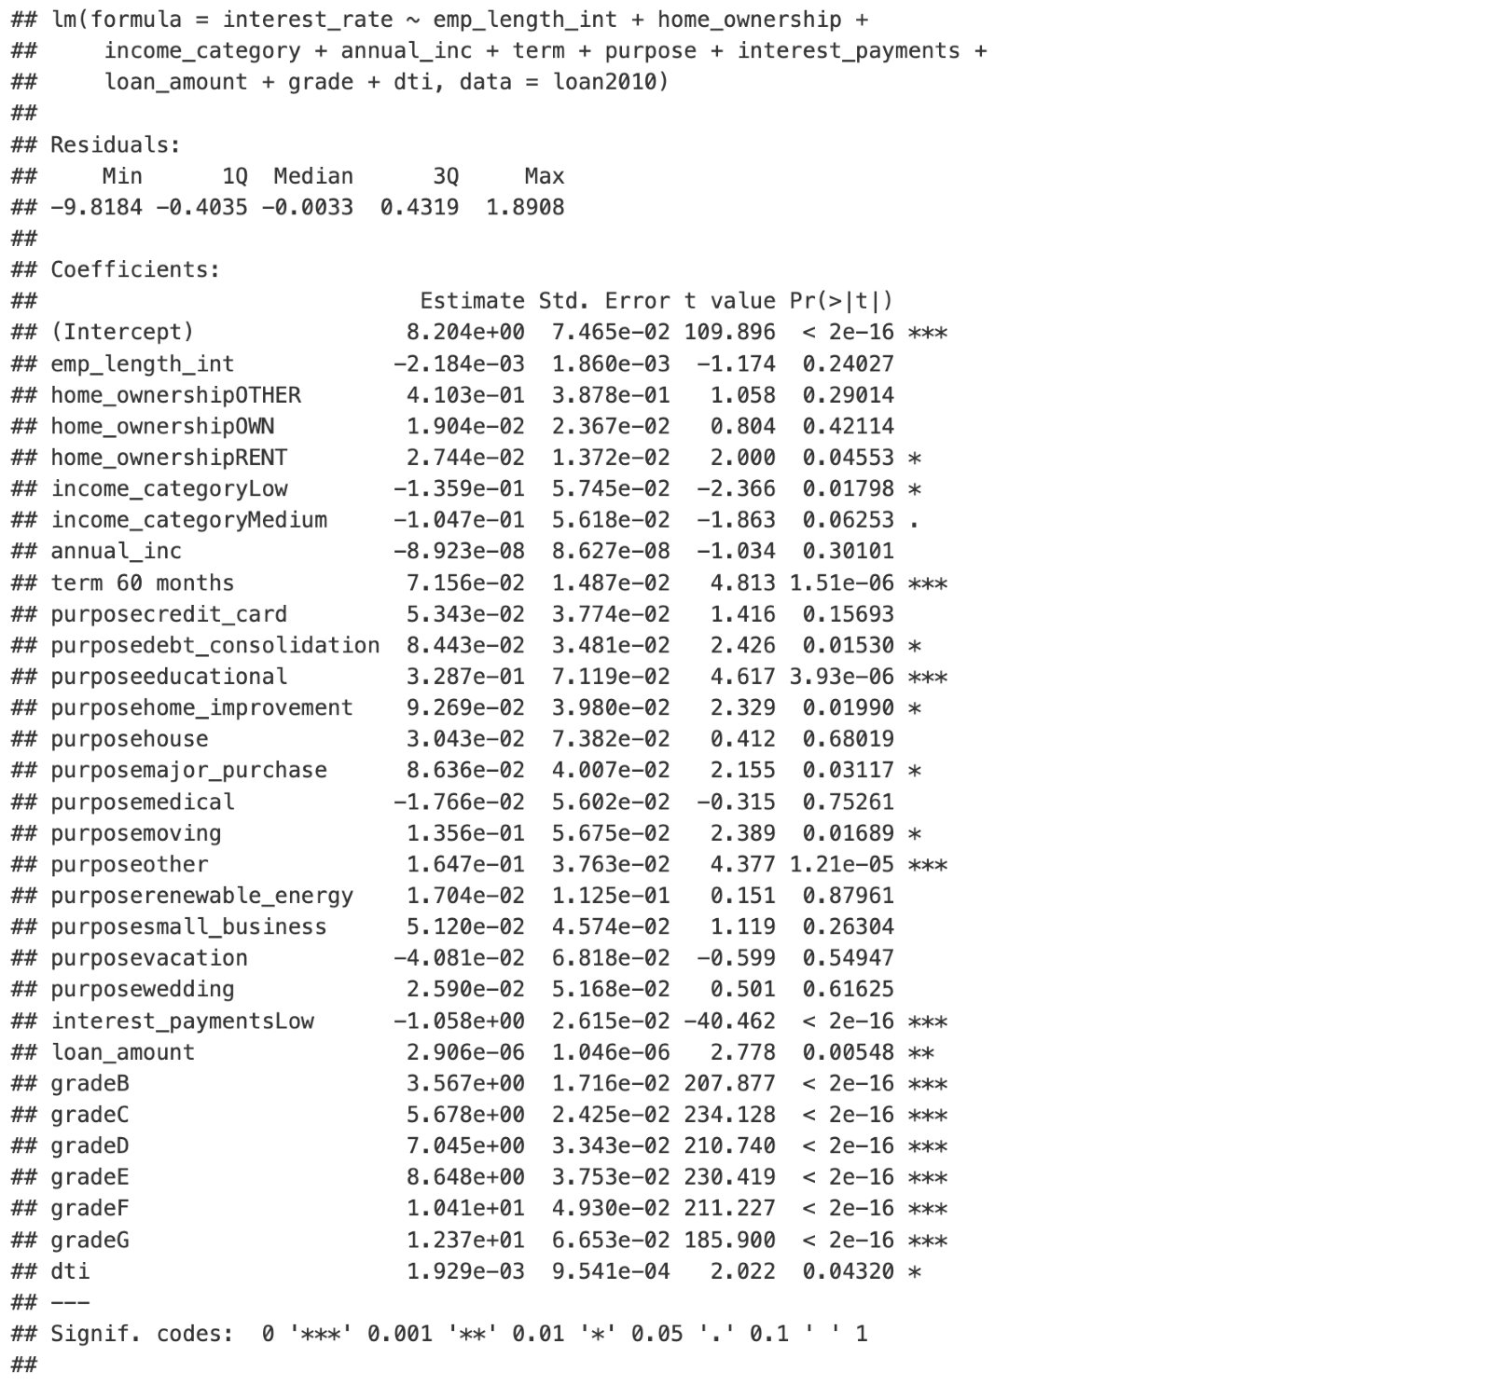
Model building:
Start with the full model:
Here we have adjusted R squared-value 0.963 and RSE of 0.6711

Slide 6
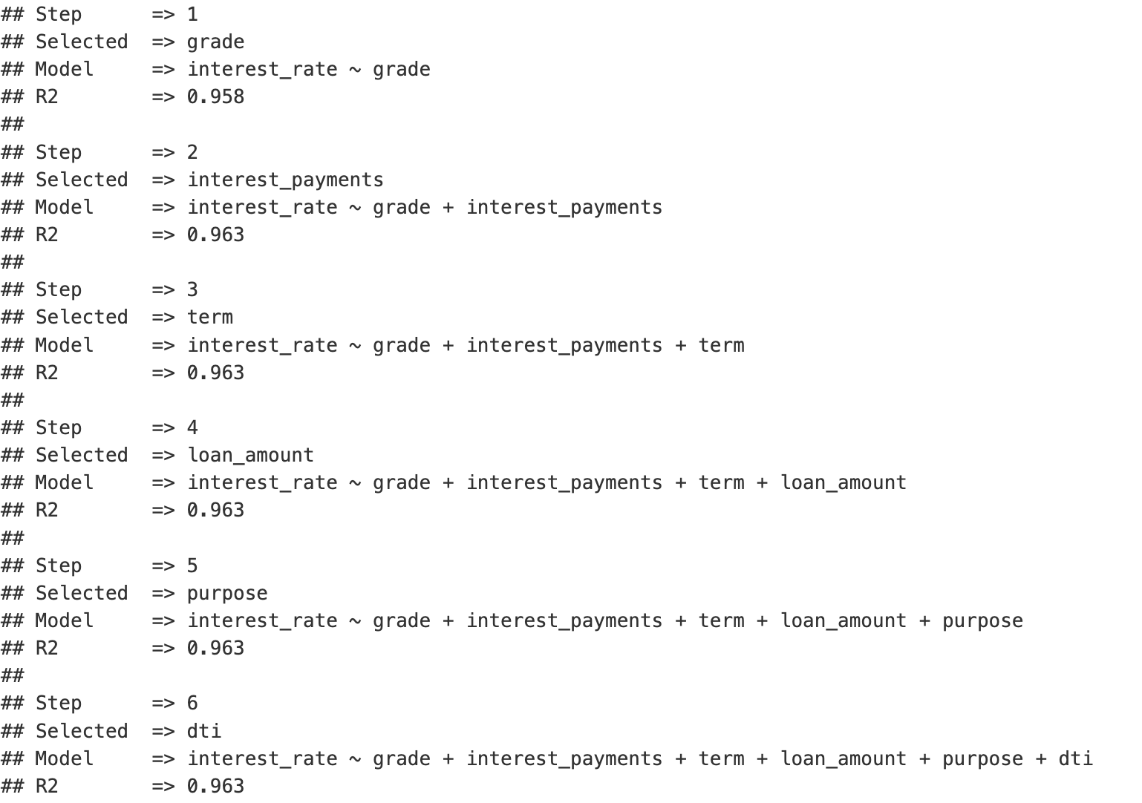
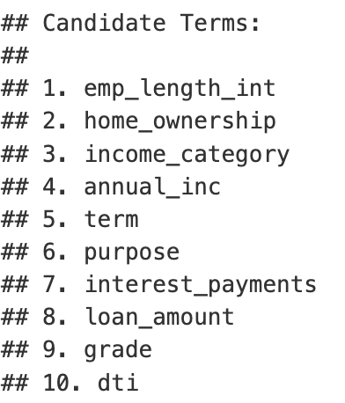
Then we performed variable selection:
Reduced model has 6 variables

Slide 7
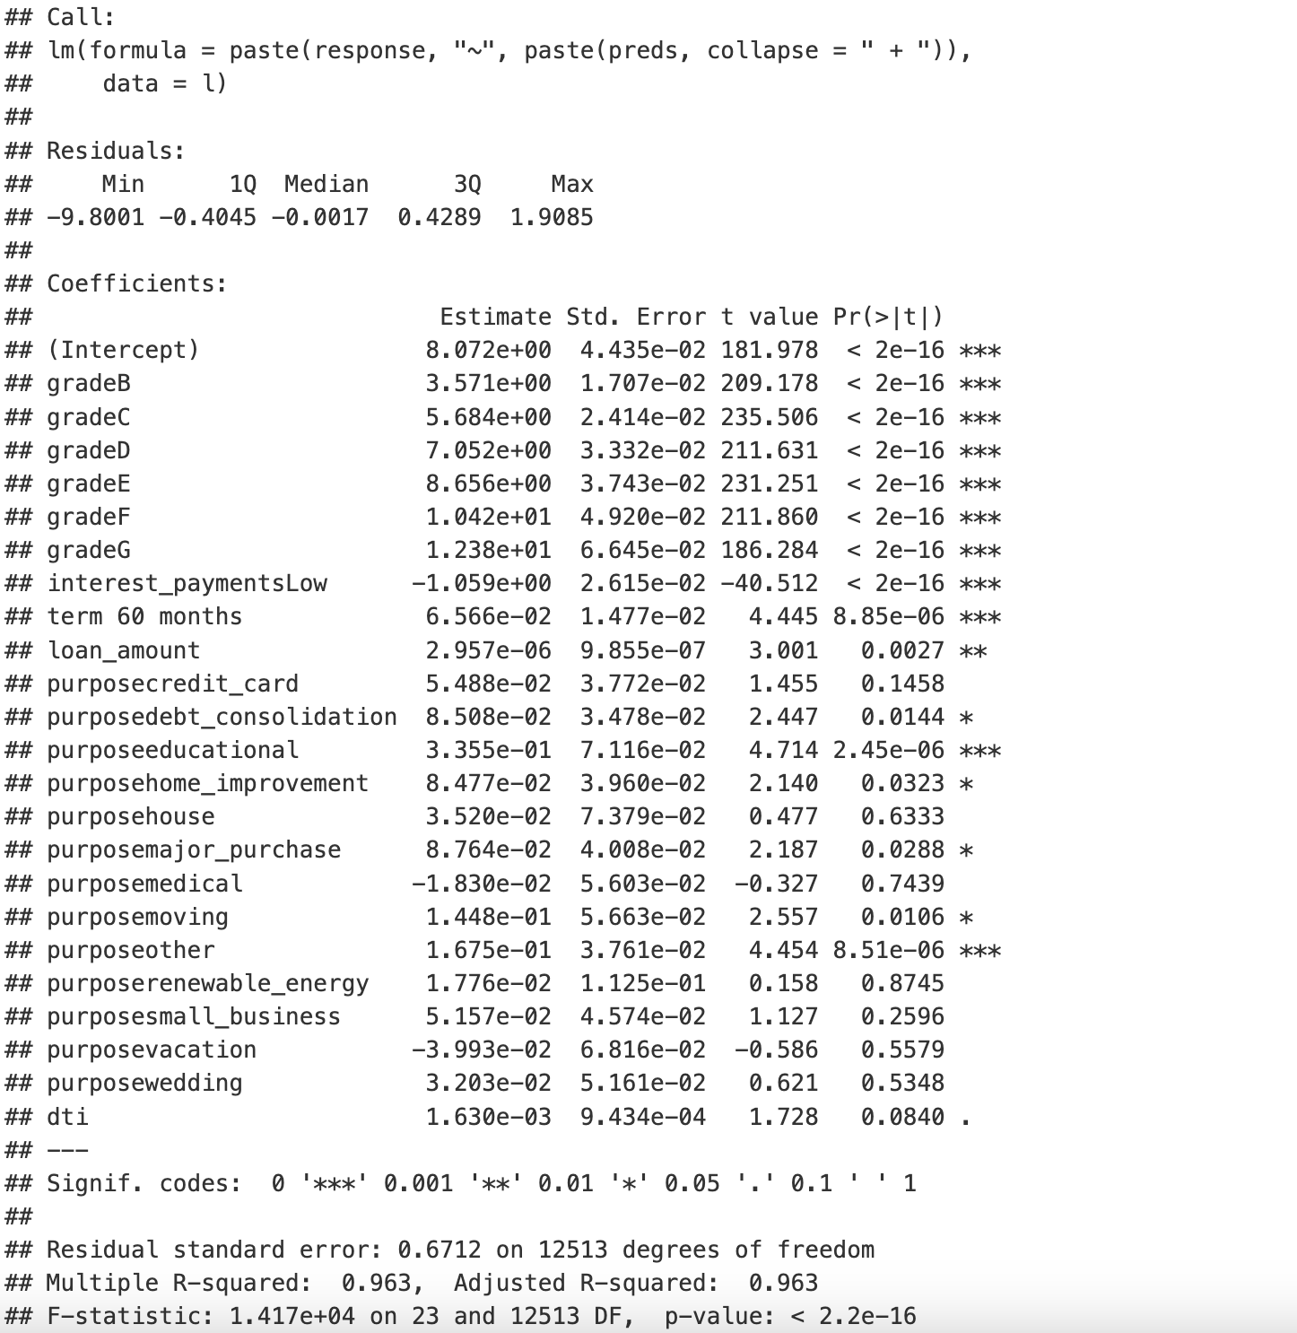
Summary of Reduced model after variable selection:
We have the exact same adjusted R-squared value as the full model but the RSE is just a little lower so we decided to use the full model.
We did include an interaction model as well but literally no interaction term is significant and there is only an 0.24% increase in adjusted R squared value and RSE only improved by 0.03.
Therefore, its result also worked in favour of using the full model as the final model.

Slide 8
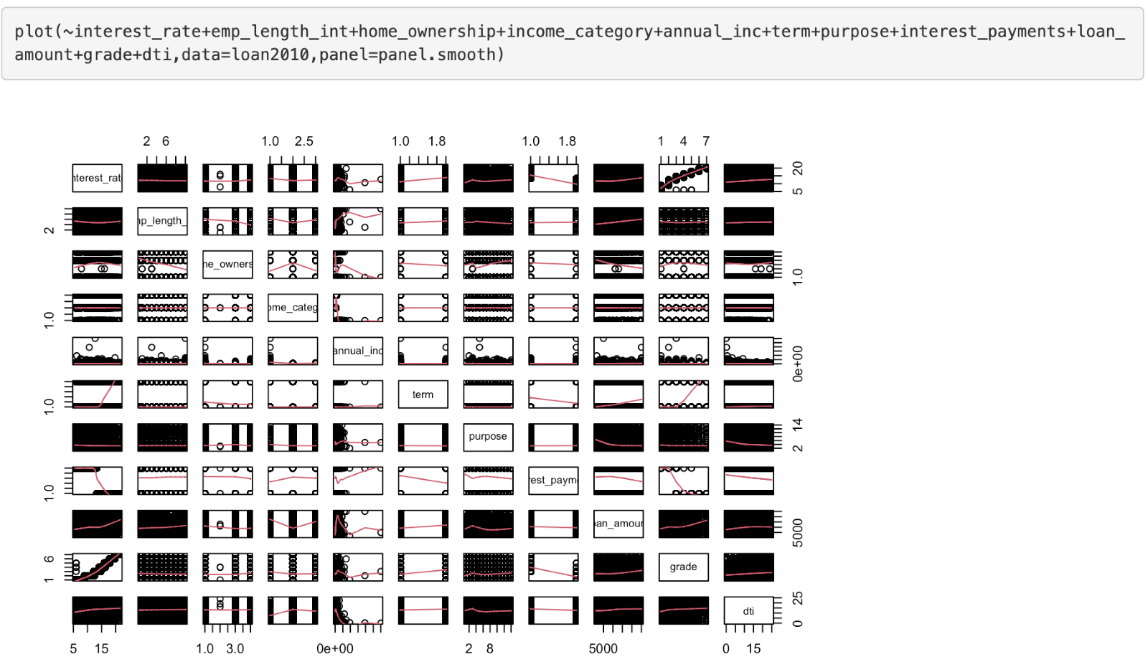
When interest_rate is on the y-axis, it has relatively linear relationship with all other predictors, so no terms needs to be a higher order.

Slide 9
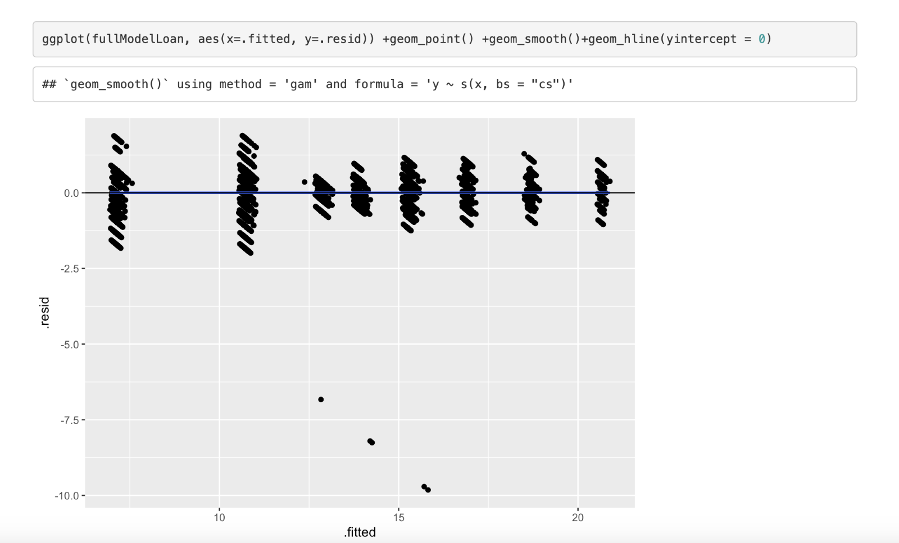
Linearity Assumption:
Perfectly linear residuals vs fitted!

Slide 10
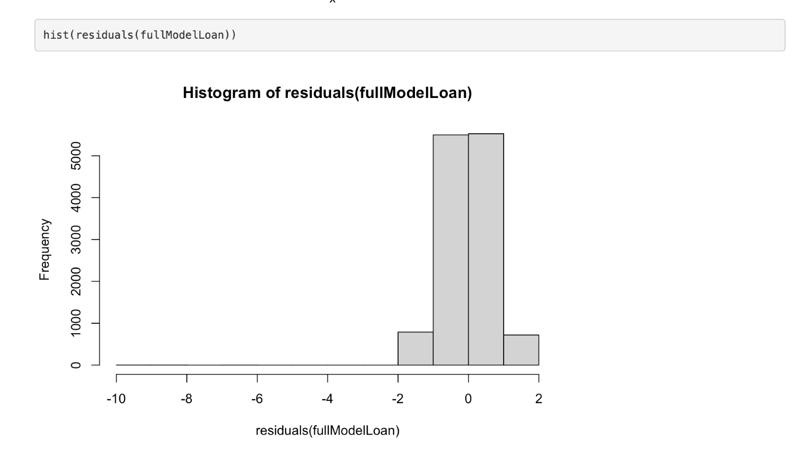
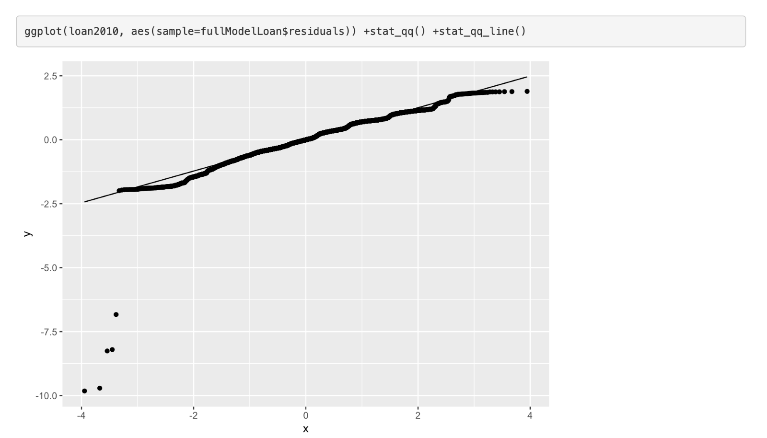
Normality Assumption:
Perfectly symmetrical histogram and almost perfectly linear QQ-plot.
Therefore, normality assumption is also met for our model!

Slide 11
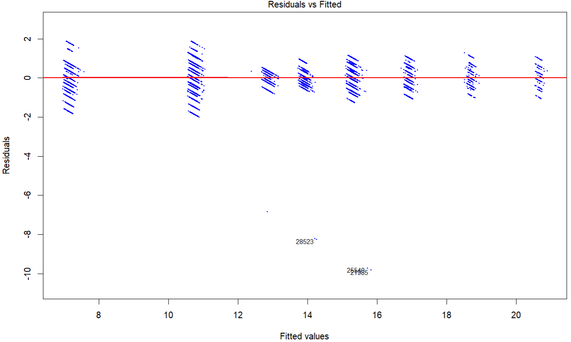
Independence Assumption:
Randomly scattered residuals around zero, indicating no dependency

Slide 12
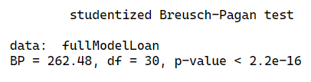
Equal Variance Assumption:
The Breusch-Pagan test (p < 0.05) indicates heteroscedasticity, but no transformation was applied as parameter estimates remain reliable in large datasets due to the central limit theorem.

Slide 13
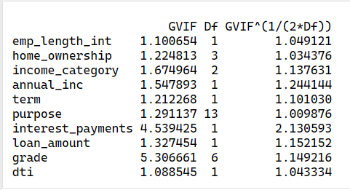
Multicollinearity Assumption:
VIF and adjusted GVIF values show no significant multicollinearity, with all predictors below 10 and most adjusted values under 2. Interest Payments (2.13) and Grade (1.15) are slightly elevated but still acceptable. No corrective actions are necessary.

Slide 14
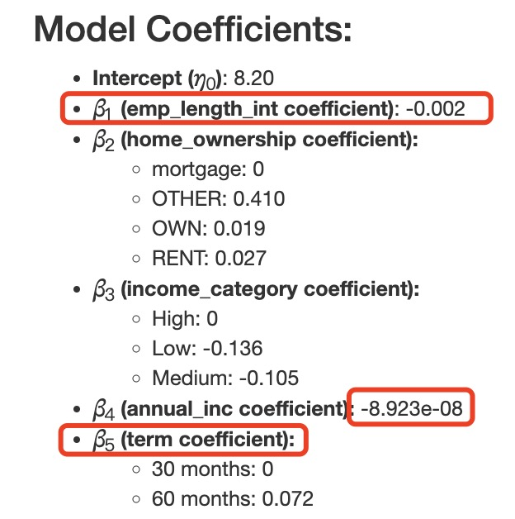
Results : Final Model & Interpretation
For simplicity, the variables annual income and loan amount can be removed.
Employment Length: For each additional year of employment, the interest rate decreases by 0.002. While a longer employment history slightly reduces the interest rate, the effect is minimal.
Loan Term: The longer the loan term, the higher the interest rate-basically similar to how it works with savings.

Slide 15
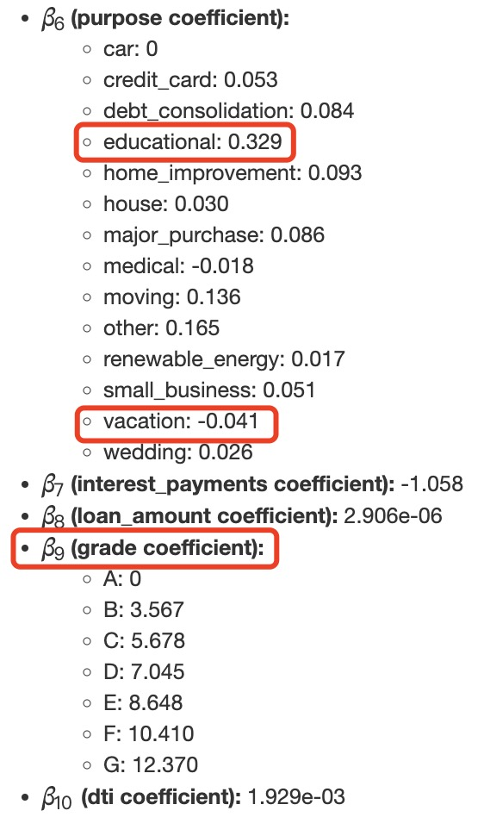
Results : Final Model & Interpretation
Purpose of Loan: Educational loans are strongly associated with higher interest rates, while vacation loans have a slightly negative effect on interest rates.
Loan Grade: Loan grade has the most significant impact on the interest rate. Higher-risk grades are associated with higher predicted interest rates, reflecting the increased risk for lenders.

Slide 16
Discussion and Future Work:
Objective: Predict interest rates based on independent variables such as employment length, home ownership, loan amount, etc.
Key findings:
Full Model vs Step wise model:
Adjusted R squared: Both models explain 96.3% of variability in interest rates.
RSE: The full model had a slightly lower Residual Standard Error, making it a better fit.
Interaction terms:
Adding interactions slightly improved Adjusted R² but many were not significant.
This suggested possible overfitting when increasing model complexity.
Assumptions:
All assumptions for linearity, normality, independence and multicollinearity were met, confirming model validity.
Linear relationships found, so no higher order terms were added.
Future work:
Explore non-linear models for capturing complex relationships.
Improve data by adding credit score history and loan repayment performance for better predictions.

Slide 17


Slide 18
References:
Nicholashagemann. (2021, 07 30). Predicting Loan Interest Rates. Retrieved from Medium: https://medium.com/@nicholashagemann0/using-machine-learning-to-predict-interest-rates-and-identify-the-strongest-predictors-aed36ae677c5
Federal Reserve. (2020, March 17). How banks decide whether to lend to you. https://www.federalreserve.gov/credit.htm
Hayes, A. (2024, 05 26). Multicollinearity: Meaning, Examples, and FAQs. Retrieved from Investopedia: https://www.investopedia.com/terms/m/multicollinearity.asp#:~:text=Multicollinearity%20is%20a%20statistical%20concept,in%20less%20reliable%20statistical%20inferences.
Using Feature Selection to Improve Model Performance. (2024, 05 13). Retrieved from nobledesktop: https://www.nobledesktop.com/learn/python/using-feature-selection-to-improve-model-performance#:~:text=in%20Machine%20Learning-,Feature%20selection%20is%20a%20critical%20step%20in%20the%20machine%20learning,model%20interpretability%2C%20and%20improve%20ac
How is Data Science used in Finance? Benefits & Applications. (n.d.). Retrieved from https://aimconsulting.com/insights/data-science-finance-benefits-applications-risks/#:~:text=Financial%20institutions%20can%20leverage%20data,for%20their%20products%20and%20services.: https://aimconsulting.com/insights/data-science-finance-benefits-applications-risks/#:~:text=Financial%20institutions%20can%20leverage%20data,for%20their%20products%20and%20services.

